Slide 1
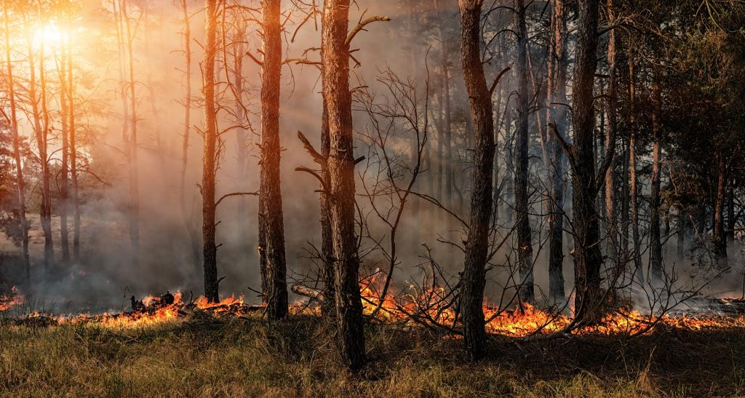
Study of wildfires in the us For the years 1992-2015
Nick Cunnington

Slide 2
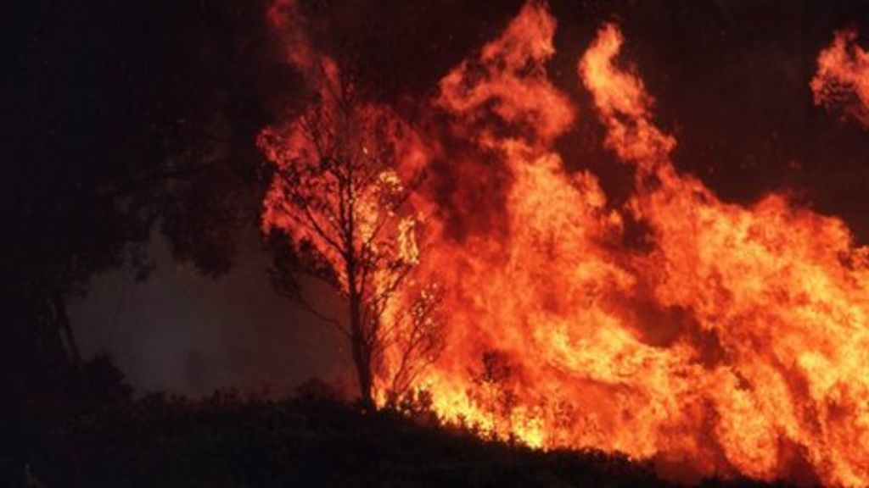
Project brief
Every year wildfires destroy millions acres of countryside, cause damage to buildings and infrastructure and lead to fatalities.
Using this dataset of all the 1.88 million wildfires that occurred across the United States from 1992 – 2015, this project aims to provide some insights that will hopefully aid planning for the future provisioning of wildfire prevention and emergency response.
The main questions that are to be answered are:
Have the occurrences of wildfires increased or decreased over the recording period?
Has there been a significant change in the cause of wildfires over this time?
Do the causes of wildfires vary significantly between States?
Do most fires occur at the same time country wide?

Slide 3
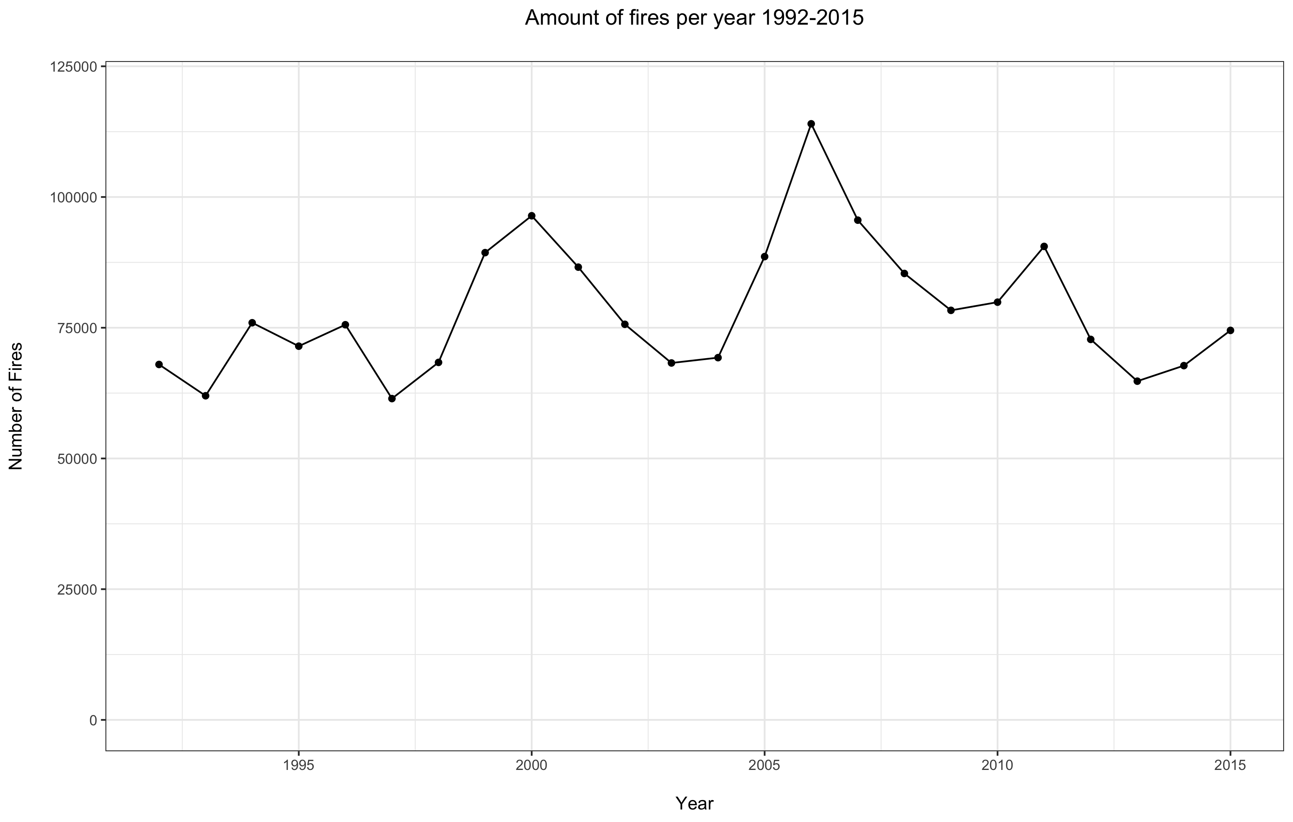
1) Have occurrences of wildfires increased or decreased over the reporting period
From the total number of fires per year, it can be seen that there is a pattern of peaks the repeat every 4-6 years.
A seasonal model was applied to analyse the data .
No statistically significant evidence of any underlying trends of increase or decrease were found to be present.
¹⁾ https://en.wikipedia.org/wiki/List_of_heat_waves

Slide 4
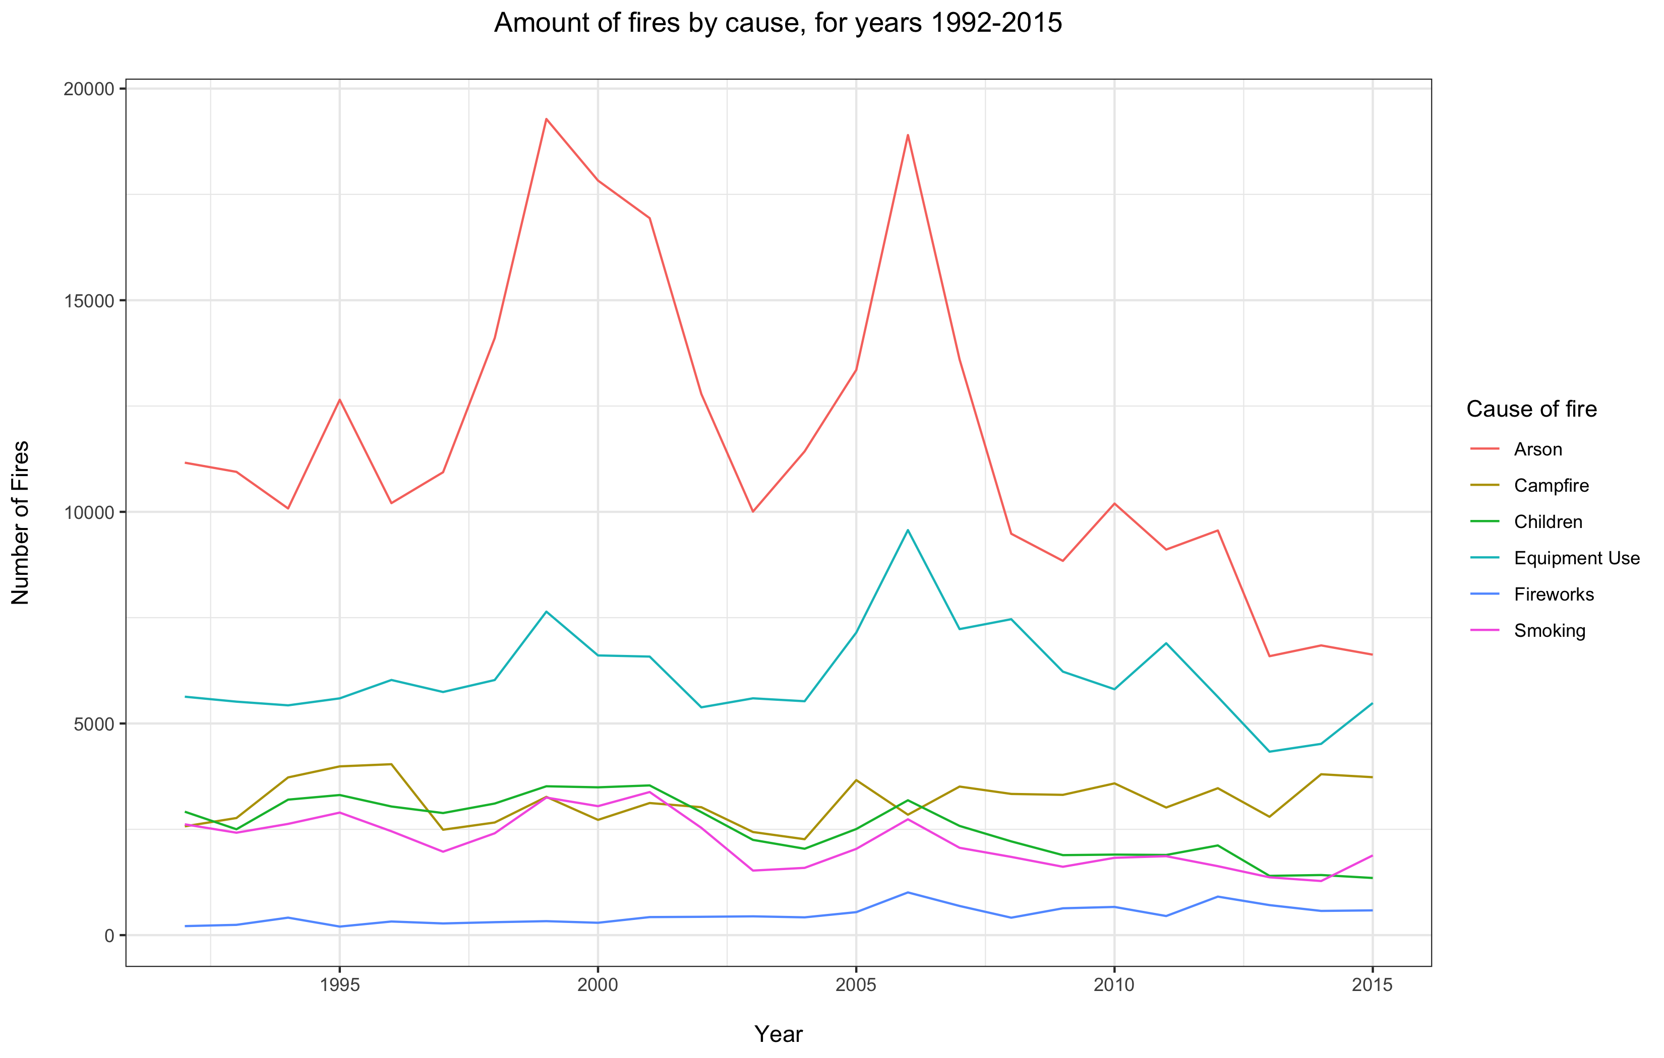
2) Have the causes of wildfires changed over the reporting period
Arson is clearly the most common cause in group 1.
There are 2 big peaks in 1999 and 2006, both of these coincide with heatwaves in the US. ^{(1).}
There is evidence to suggest a statistically significant decrease in fires due to arson, children and smoking. Campfires, equipment use and fireworks remain stationary.
¹⁾ https://en.wikipedia.org/wiki/List_of_heat_waves

Slide 5
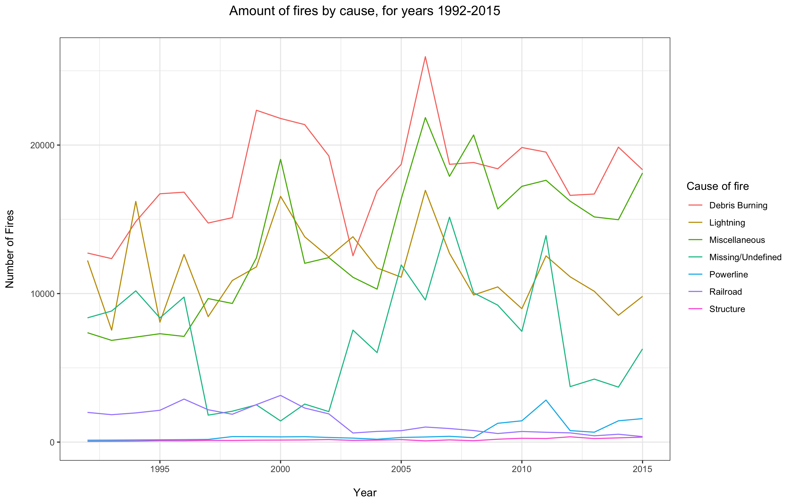
2) Have the causes of wildfires changed over the reporting period
Debris burning is the most common cause in group 2.
The peaks in 2000 and 2006 are visible in this plot are well. ⁽¹⁾
There is statistically significant evidence that fires by debris burning and miscellaneous have increased, railroad has decreased and lightning, missing, powerline and structure remain stationary.
¹⁾ https://en.wikipedia.org/wiki/List_of_heat_waves

Slide 6
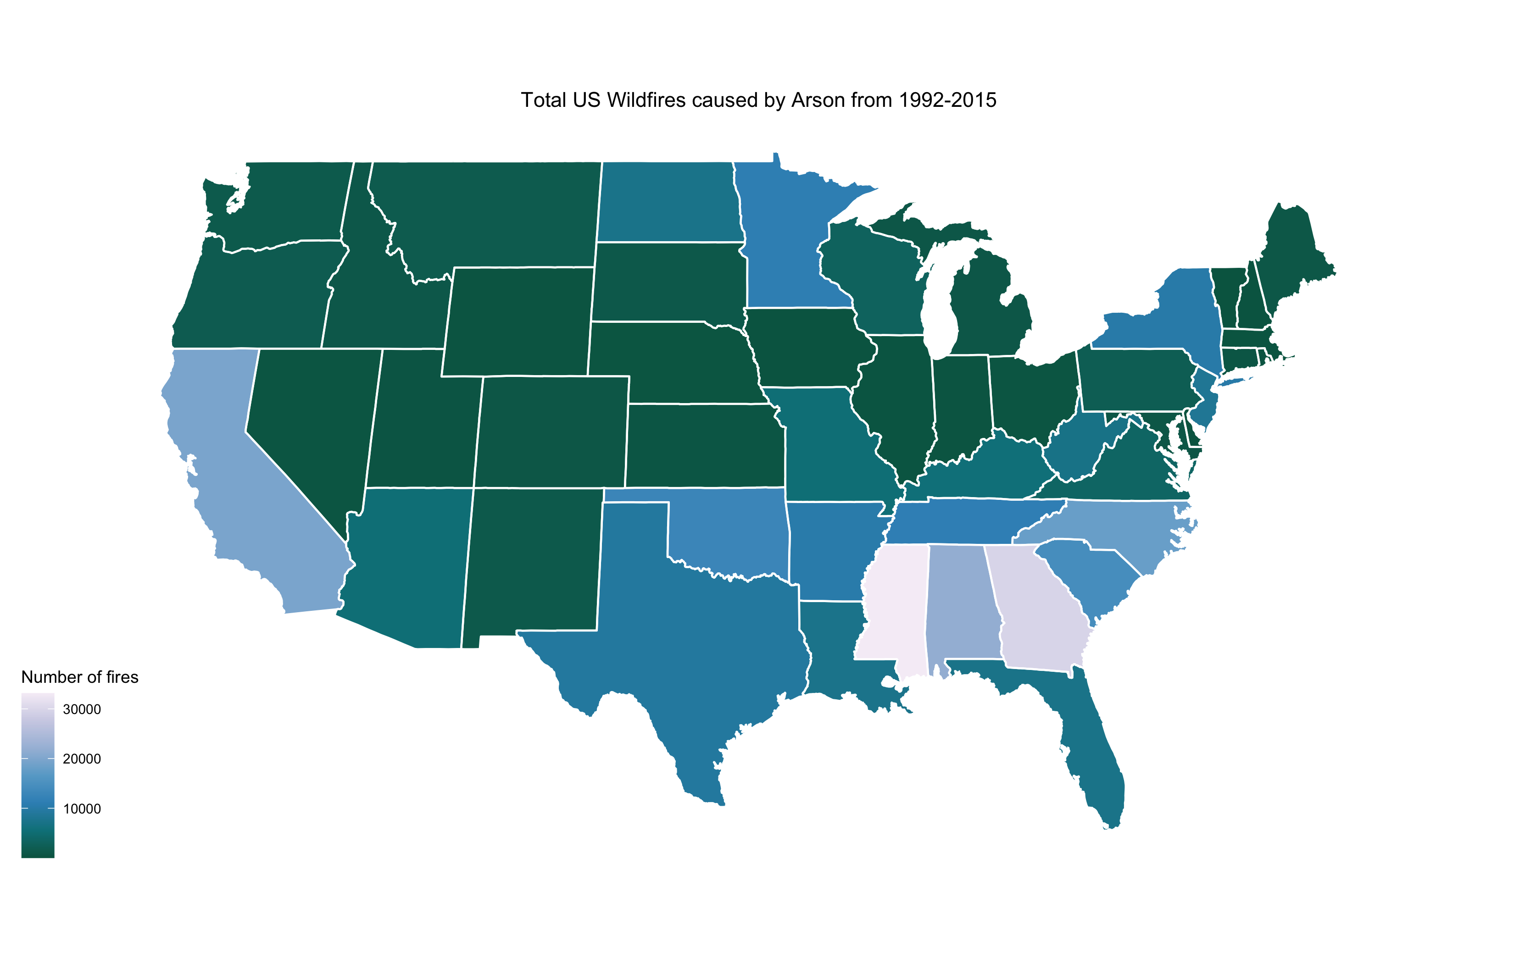
3) Do the causes of wildfires change significantly between states
There is significant variation in the causes of fires between states
Some of the more interesting observations are as follows.
The South Eastern States of Mississippi, Alabama, Georgia and North Carolina have the most fires due to Arson.
California also has a reasonably high number of arson cases per year.

Slide 7
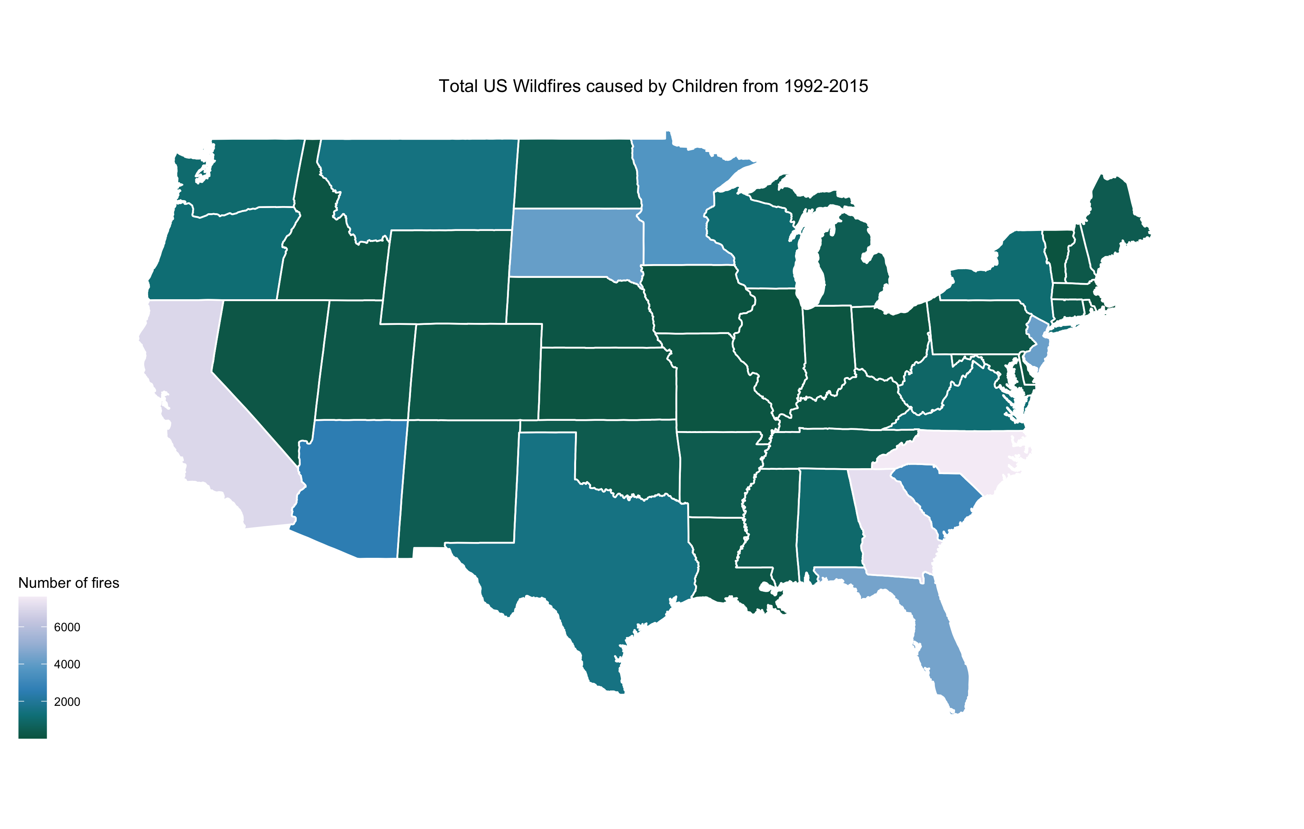
3) Do the causes of wildfires change significantly between states
The South Eastern states of Georgia and North Carolina also seem to have a reasonably large proportion of fires caused by children, as does California.
Further investigation is required to provide explanation for these findings.

Slide 8
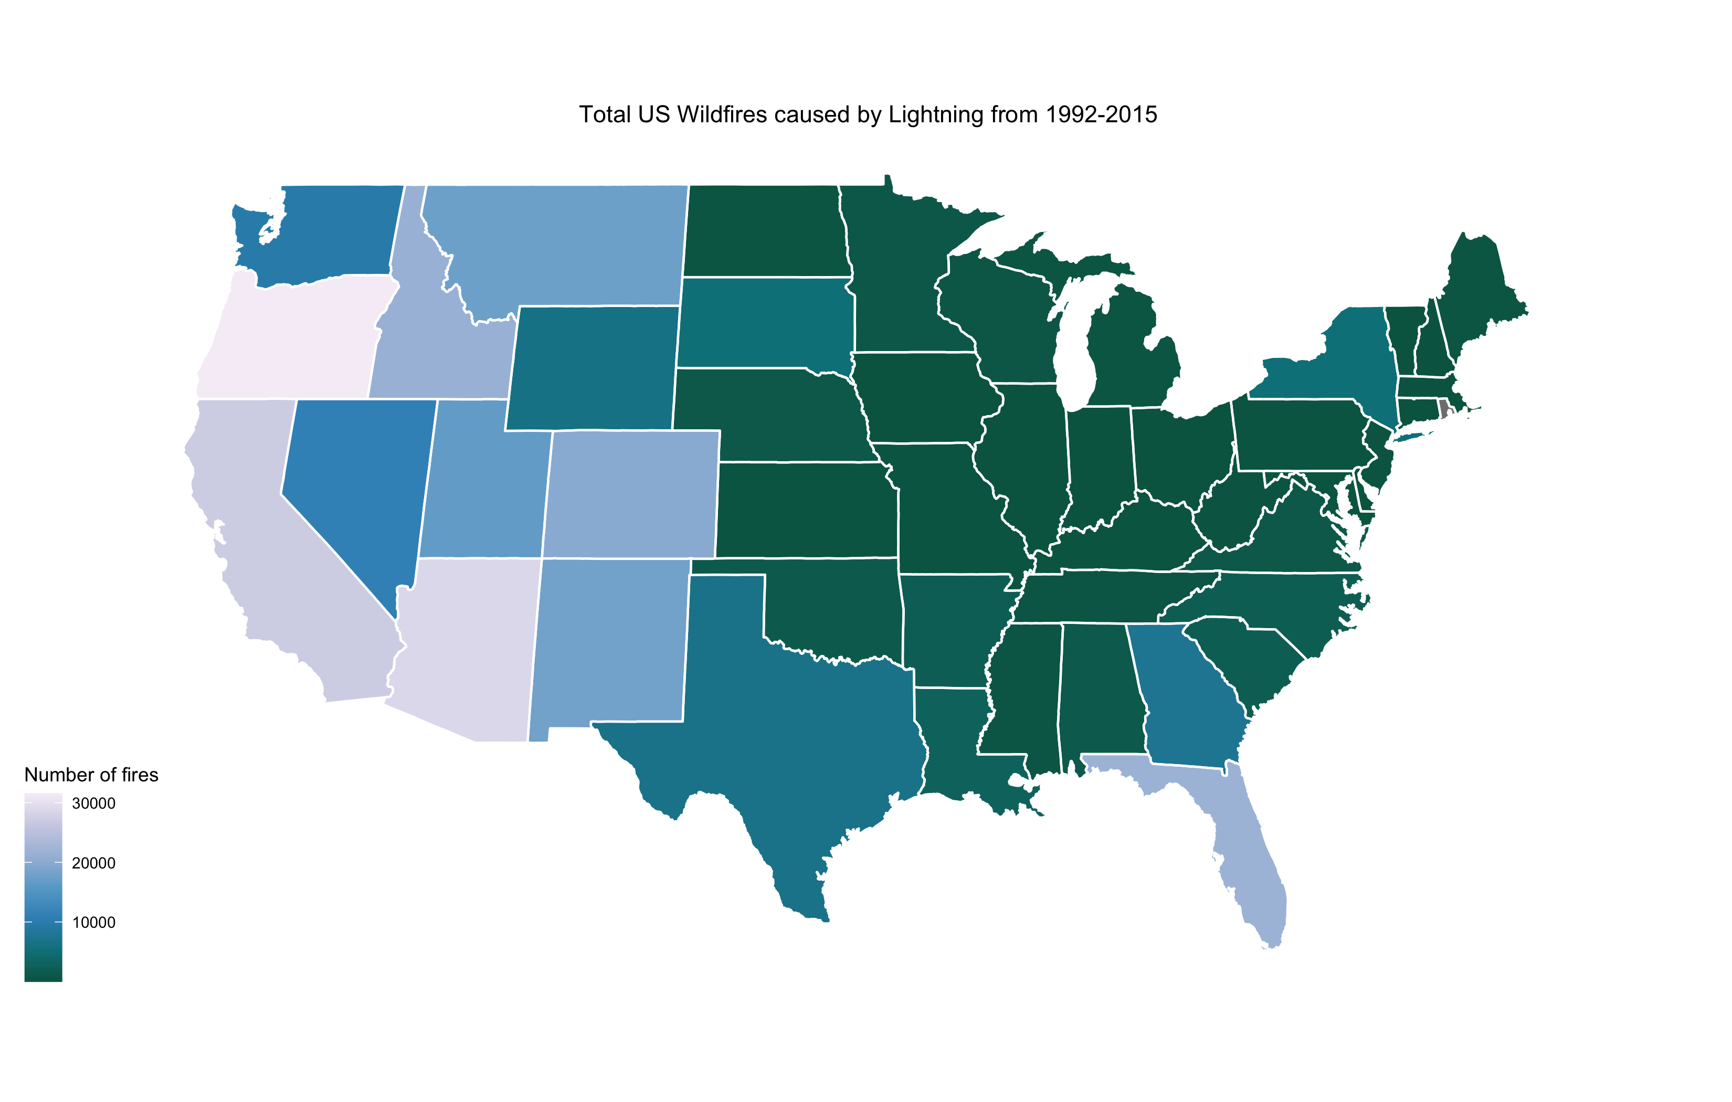
3) Do the causes of wildfires change significantly between states
Fires by lightning are definitely more common on the West coast of America.
Florida is also prone to lightning in the summer months due to tropical storms that are often present near the Caribbean.

Slide 9
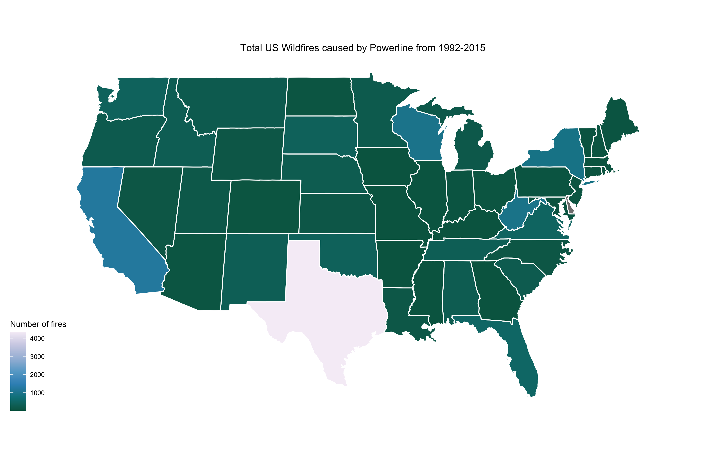
3) Do the causes of wildfires change significantly between states
Texas has a large proportion of fires due to powerlines.
This may be in part to do with the vast areas of open grasslands used for agriculture and cattle, which become extremely dry and a source of fuel. ⁽²⁾
This could also highlight potential problems with the powerline infrastructure itself and requires more investigation.
⁽²⁾ https://uk.reuters.com/article/us-wildfires-texas/trees-and-power-lines-caused-major-texas-fire-idUSTRE78J76A20110920

Slide 10
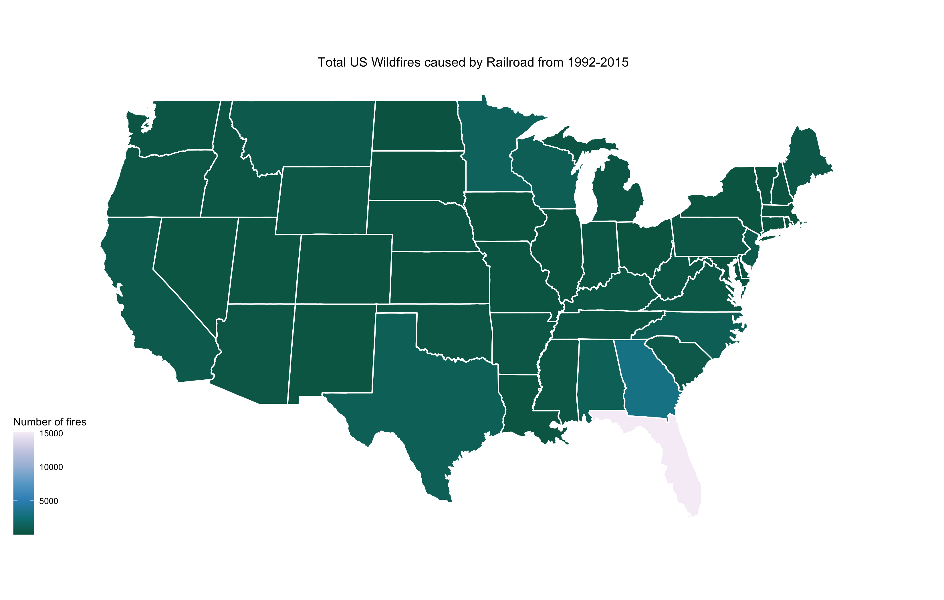
3) Do the causes of wildfires change significantly between states
It has become apparent that there may be some inaccuracies in the data collected for the State of Florida.
For the years in the 1990s there is very large proportion of railroad fires compared to the years in the 2000s.
This seems likely due to a fire classification error.
Further investigation is required and any analysis for Florida from 1992-1999 should be considered potentially unreliable.

Slide 11
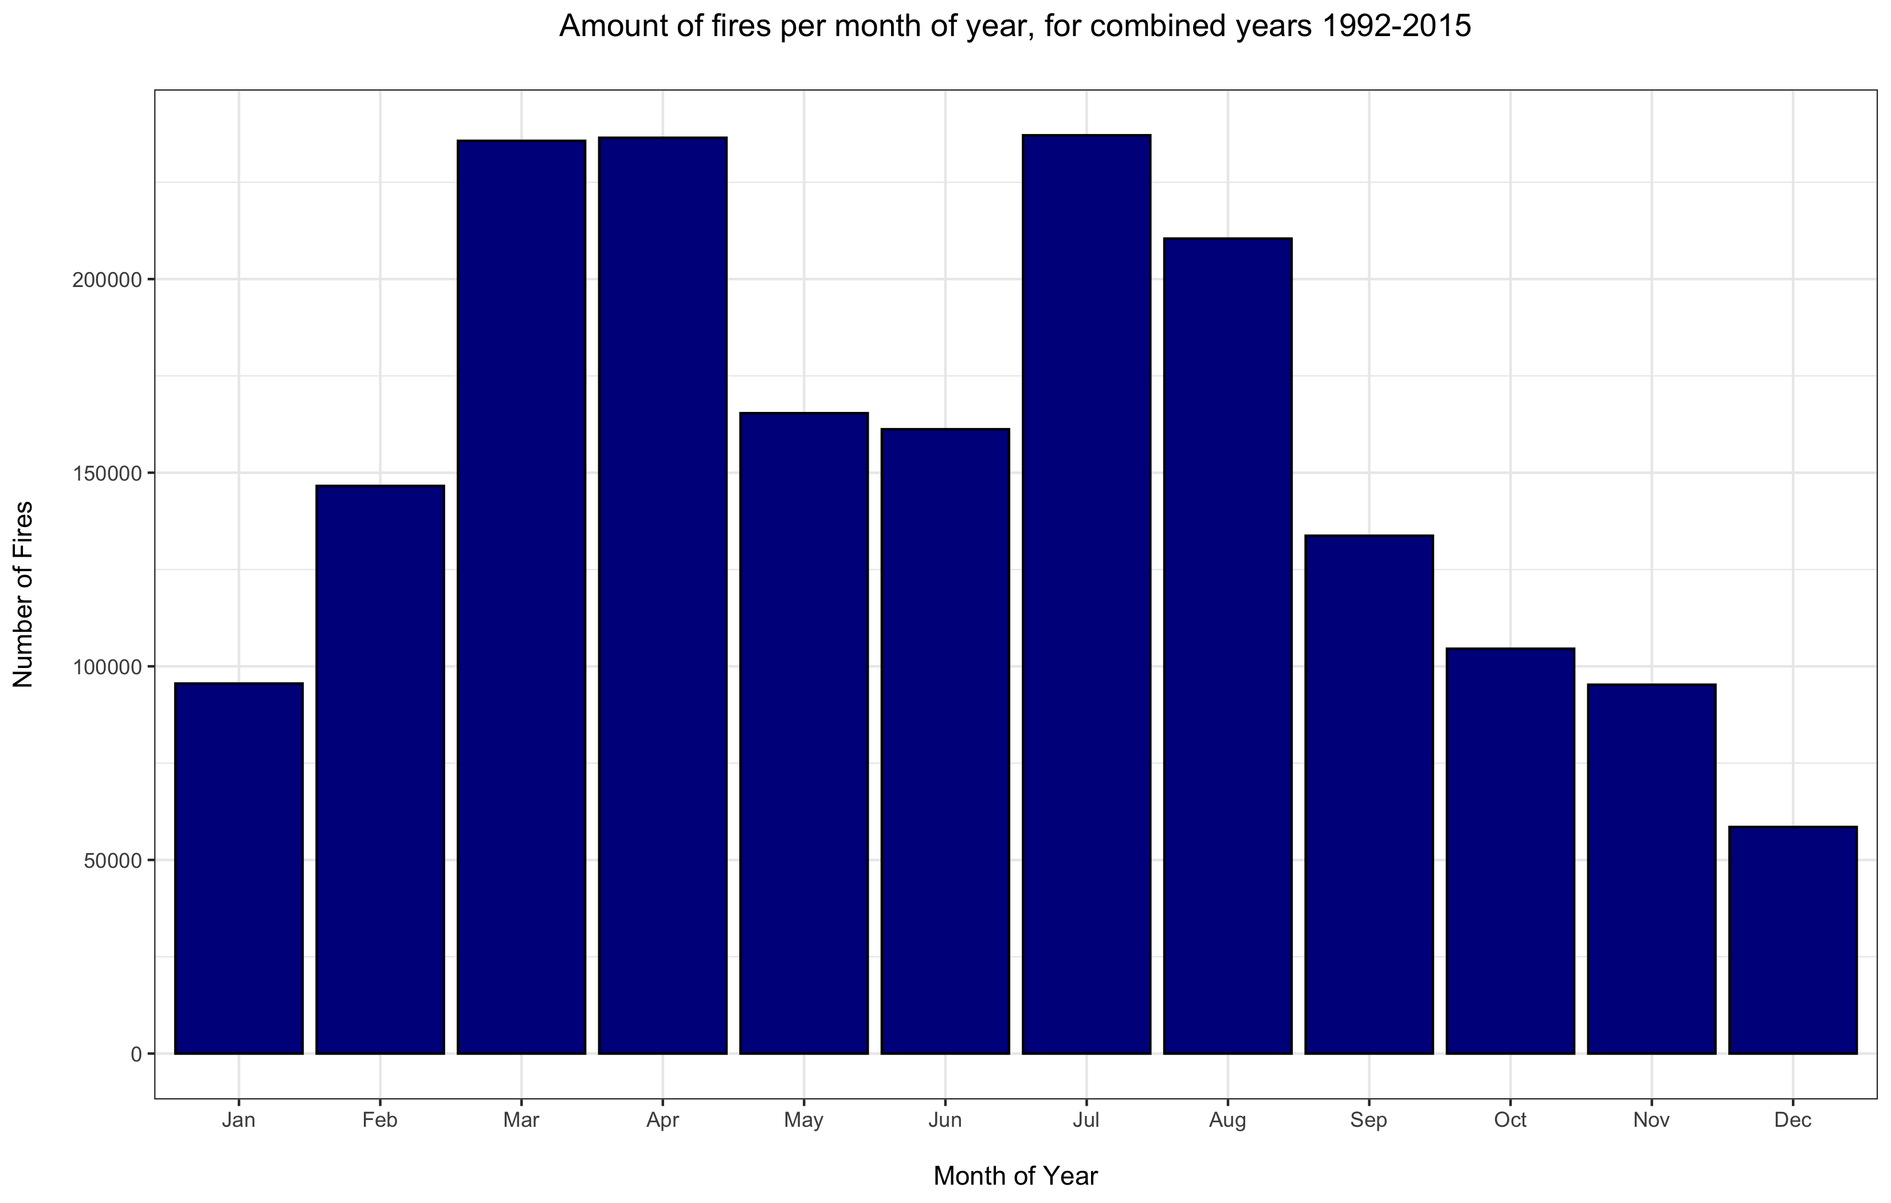
4) Do most fires occur at the same time of year country wide
There are 2 definite peaks in occurrences each year, in Mar/Apr and Jul/Aug.
I initially assumed it to be due linked to school Spring and Summer break periods. ⁽³⁾
However is more likely to be caused by climatic differences between the East and West coasts States. ⁽⁴⁾
⁽³⁾ https://en.wikipedia.org/wiki/School_holidays_in_the_United_States
⁽⁴⁾ See slide 13

Slide 12
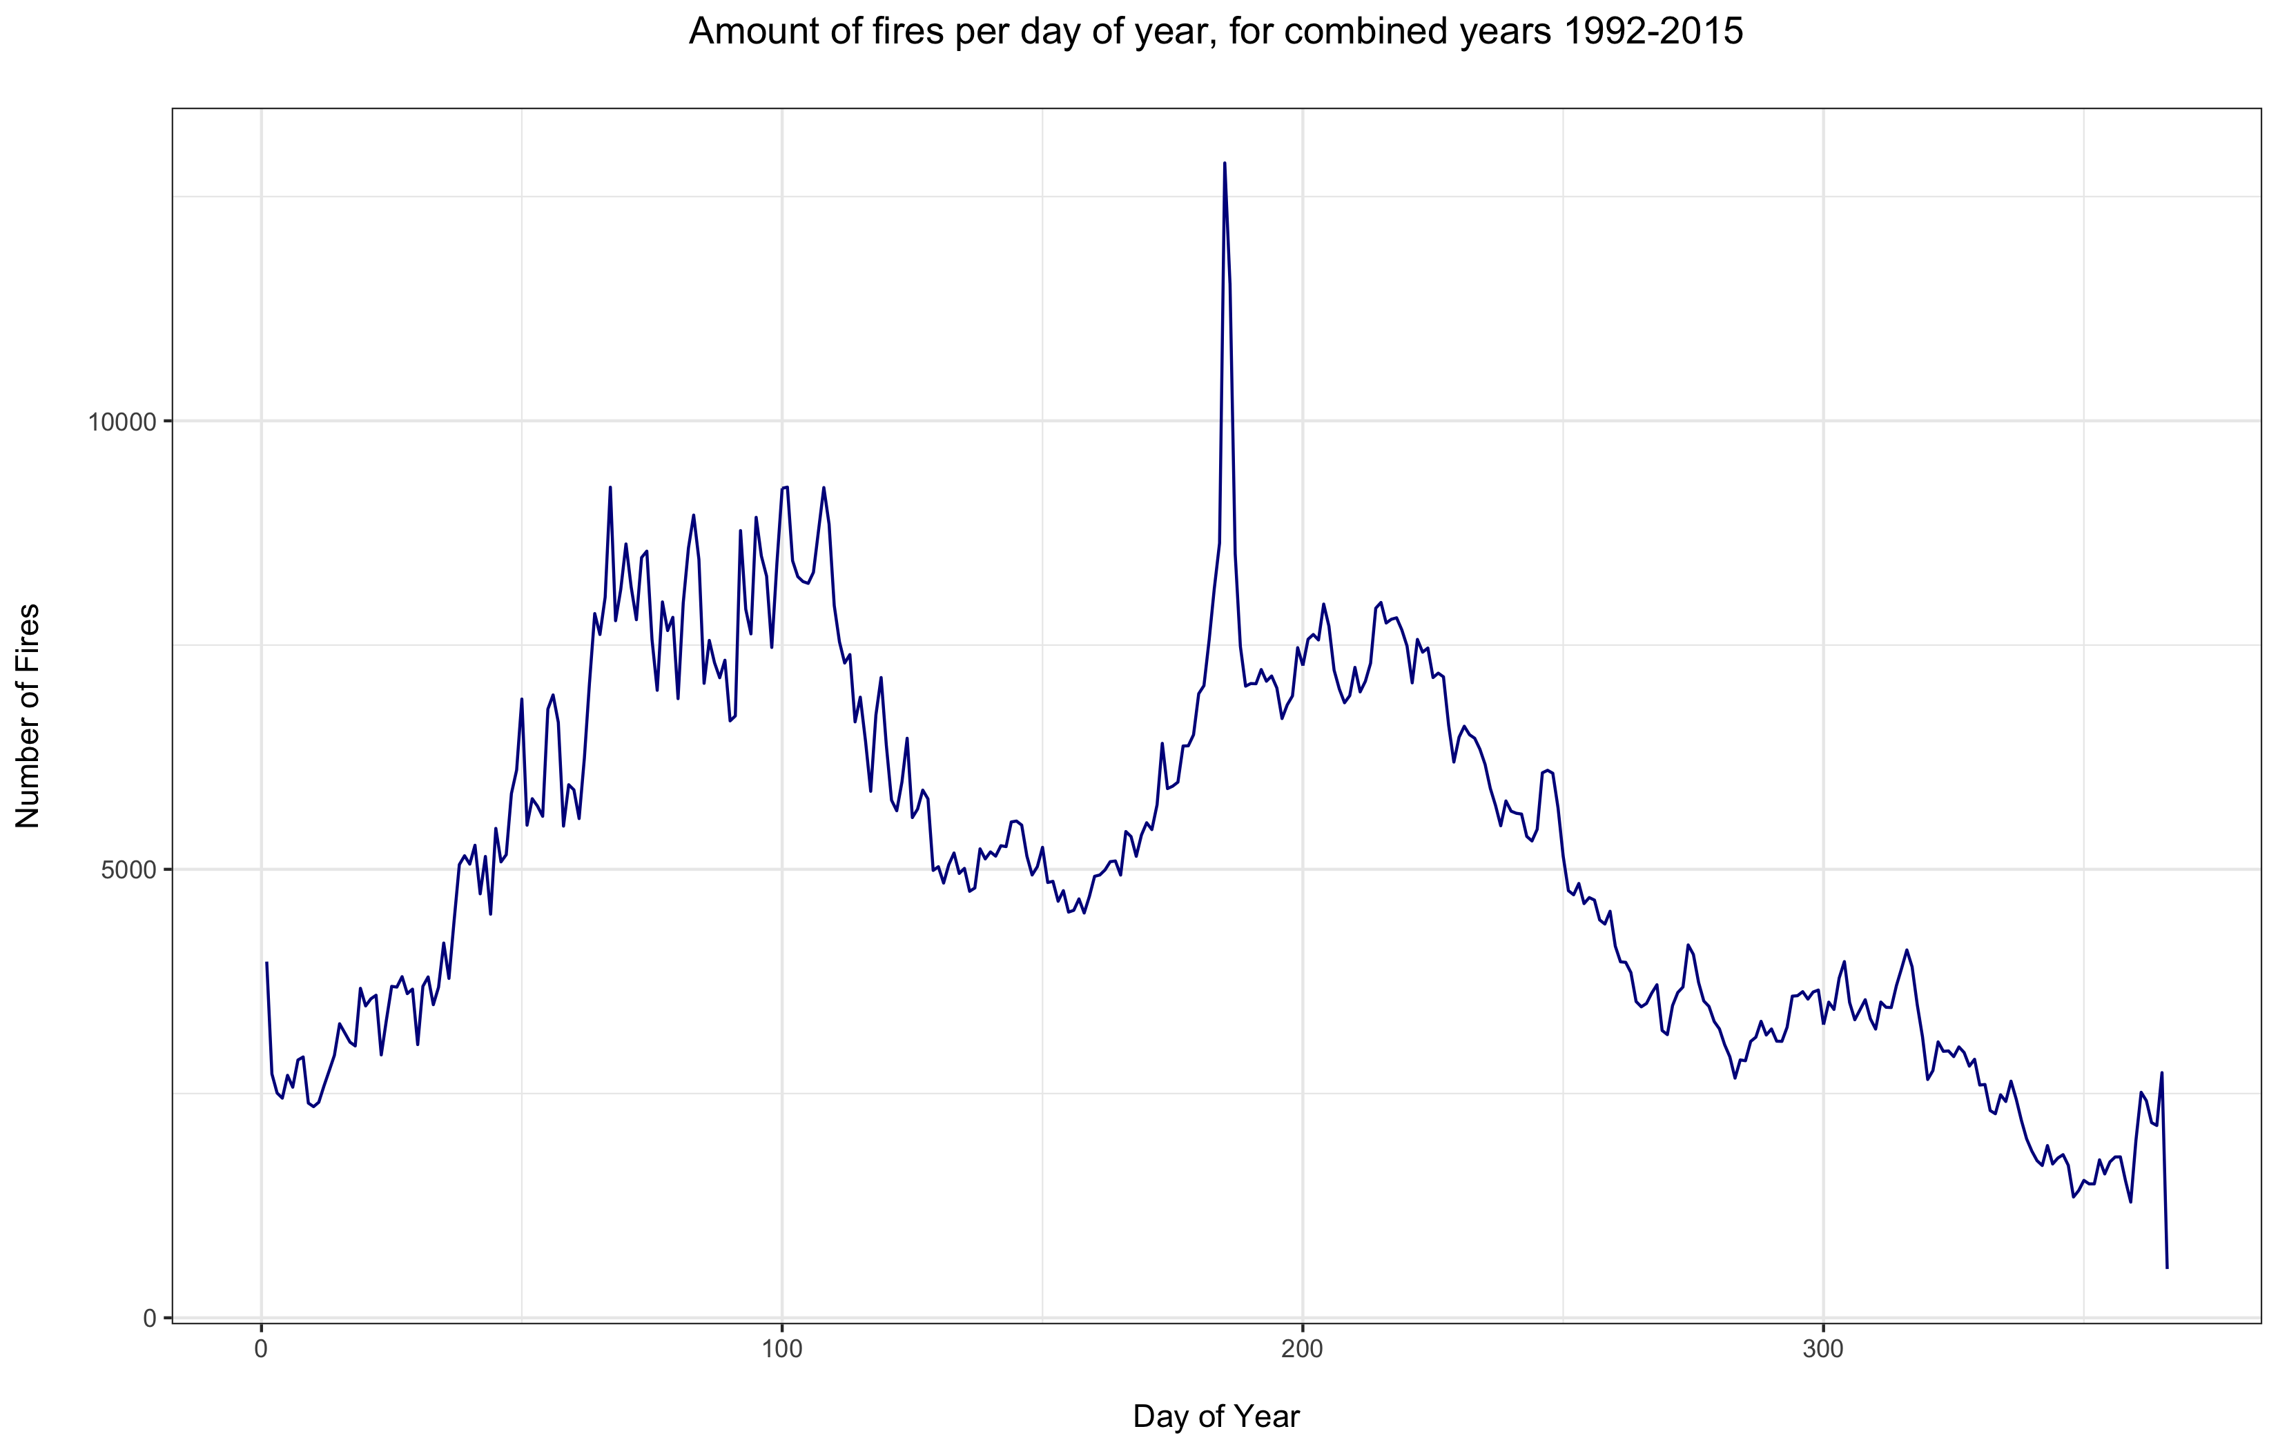
4) Do most fires occur at the same time of year country wide
Considering day number of the year peaks can still be seen around Spring and Summer.
However the is a very large spike over 2 days – 185 and 186.
Which happens to be the 4th July (US Independence Day) on normal and leap years respectively. ⁽⁵⁾
⁽⁵⁾ https://en.wikipedia.org/wiki/July_4

Slide 13
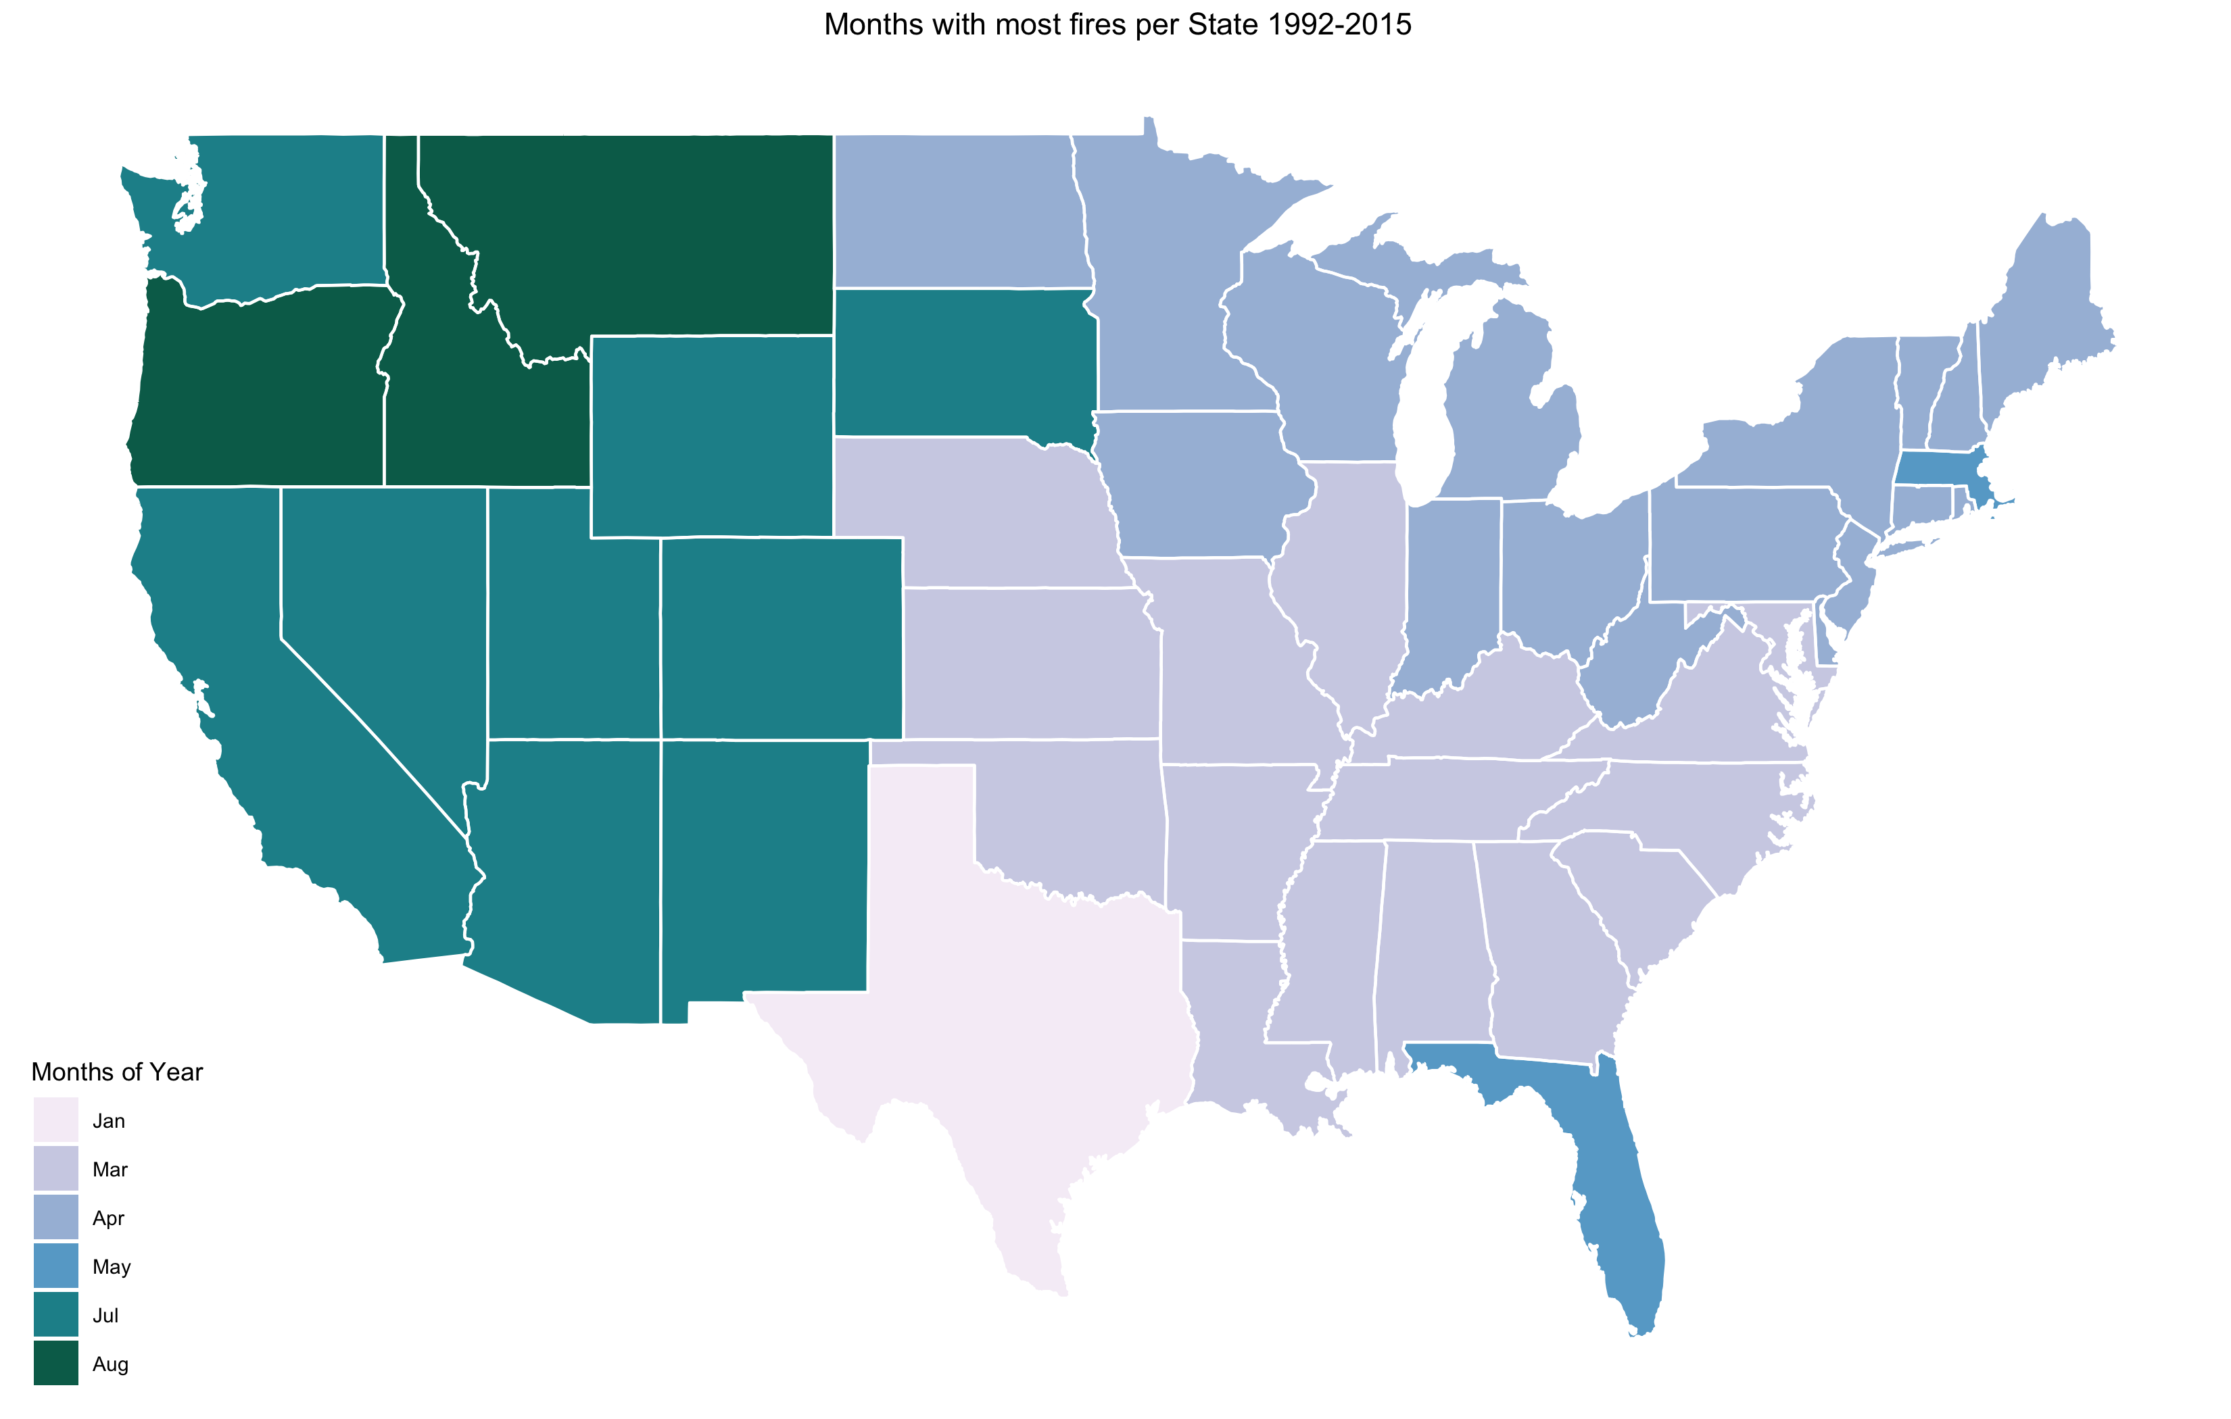
4) Do most fires occur at the same time of year country wide
As can be seen from the plot, there is a clear East/West split roughly though the middle of the country.
The east side of the US seems to have the most fires in the January – May.
The west side of the US has the most fires slightly later in May – August.
Florida is the exception due to the storms and lightning it experiences in July. ⁽⁶⁾
⁽⁶⁾ https://www.weather.gov/mlb/fl_lightning_climo

Slide 14
CONCLUSIONs and notes
Despite potential errors noted within the dataset, some interesting insights were obtained.
The overall number of wildfires over the 24 year period seems to remain mostly constant, with some yearly variation mostly dependent on climate and local factors.
Causes of wildfires do seem to be changing with time. Encouragingly fires by arson, smoking and children are decreasing, but burning debris and miscellaneous records have increased.
Given extra time I would like to further investigate the differences in causes between States and try and account for some of the reasons for the high proportion of arson in the South Eastern areas, for example.

Slide 15
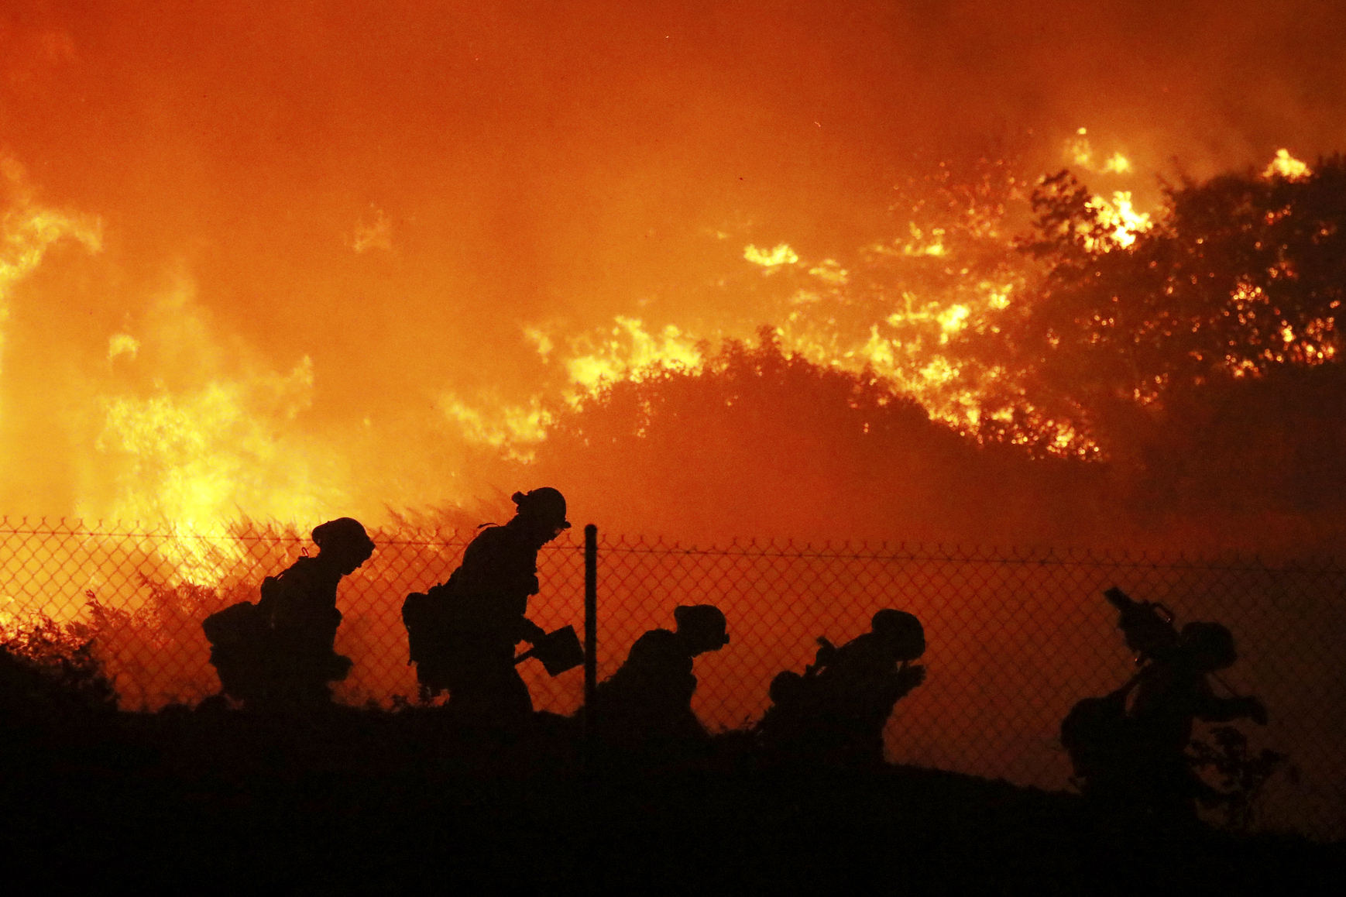
Any
Questions?

